Slide 1
Decision tree
Kiana abdollahzadeh
Setayesh norouzi

Slide 2
What is ML?
Machine learning (ML) is a branch of artificial intelligence (AI) and computer science that focuses on the using data and algorithms to enable AI to imitate the way that humans learn, gradually improving its accuracy. ML develops algorithms by learning the hidden patterns of the datasets used it to make predictions on new similar type data, without being explicitly programmed for each task

Slide 3
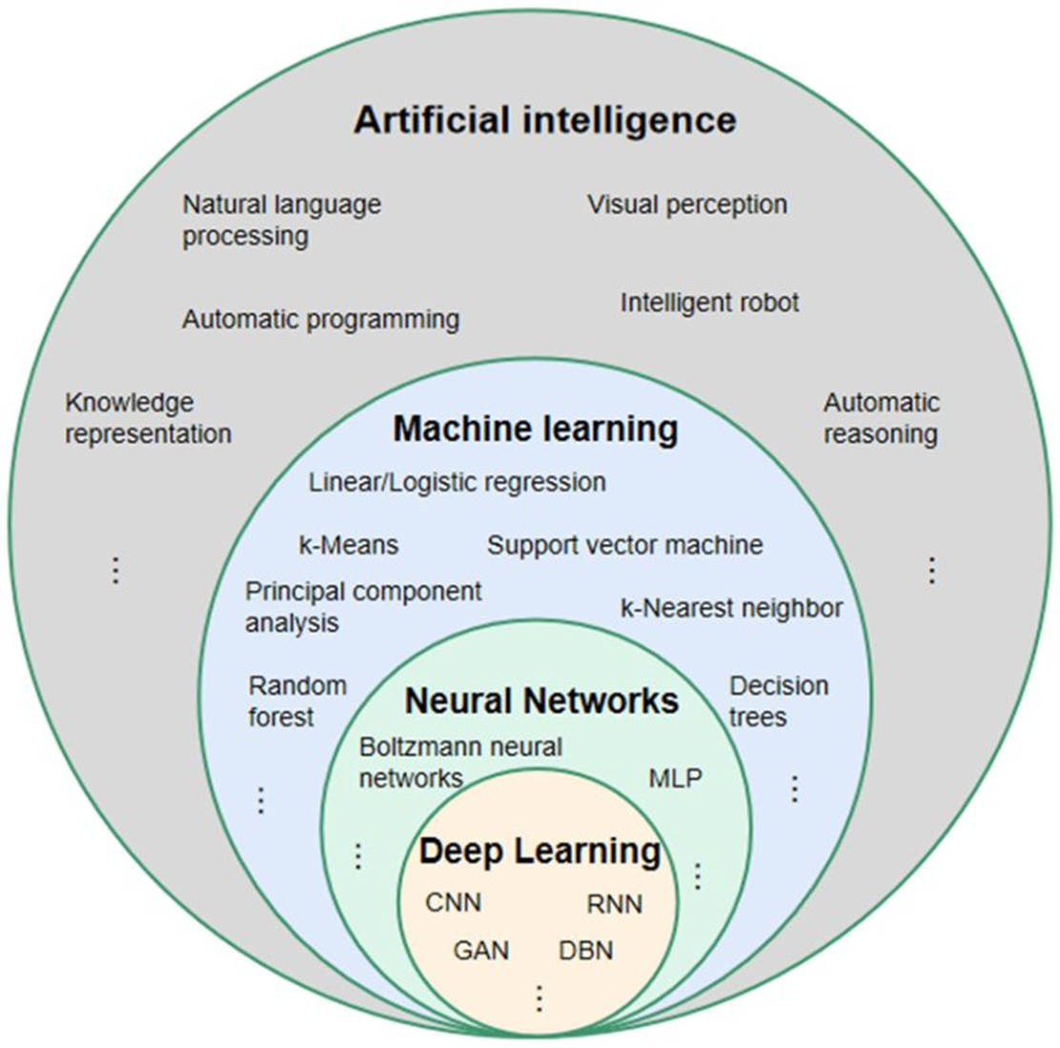

Slide 4
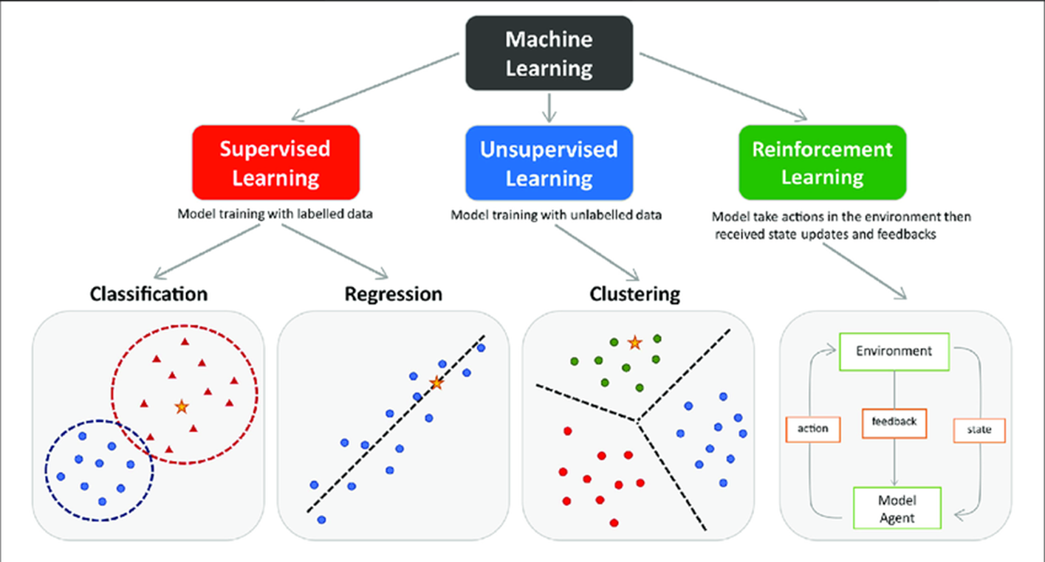

Slide 5
Supervised learning
Supervised learning is a type of machine learning algorithm that learns from labeled data. Labeled data is data that has been tagged with a correct answer or classification.
Key Points:
Supervised learning involves training a machine from labeled data.
Labeled data consists of examples with the correct answer or classification.
The machine learns the relationship between inputs (fruit images) and outputs (fruit labels).
The trained machine can then make predictions on new, unlabeled data.

Slide 6
Types of Supervised Learning
Regression: A regression problem is when the output variable is a real value, such as “dollars” or “weight”.
Classification: A classification problem is when the output variable is a category, such as “Red” or “blue” , “disease” or “no disease”.

Slide 7
Classification
Classification is a process of categorizing data or objects into predefined classes or categories based on their features or attributes.
The main objective of classification machine learning is to build a model that can accurately assign a label or category to a new observation based on its features.

Slide 8
Classification Algorithms
Logistic Regression
Decision Tree
Random Forest
Support Vector Machine (SVM)
Naive Bayes
K-Nearest Neighbors (KNN)

Slide 9
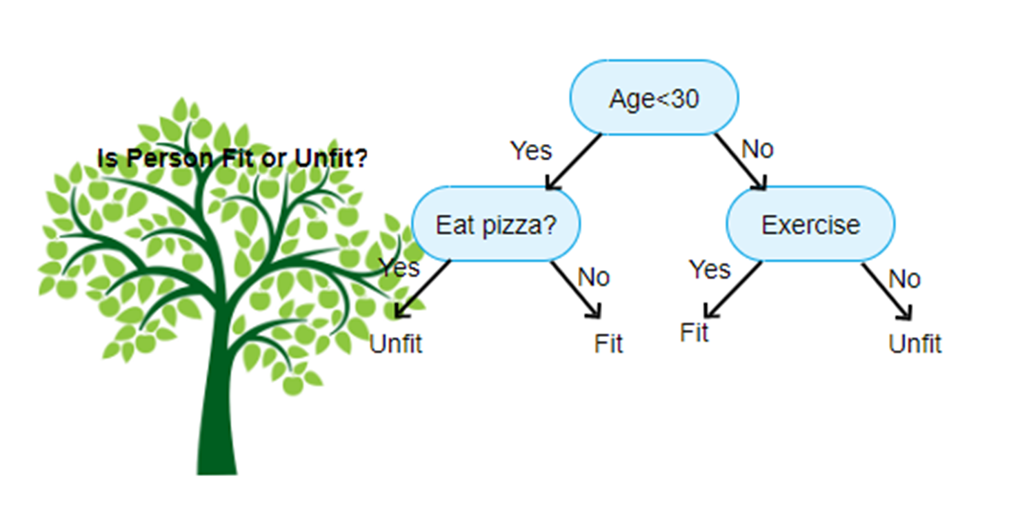
Decision Tree
A tree shaped diagram used to determine a course of action.
Each branch of the tree represents a possible decision, occurrence or reaction.

Slide 10
Advantages: It’s simple to visualize
Disadvantage :overfitting/low bias

Slide 11
TERMS:
Entropy: Is a measure of randomness or unpredictability in the dataset
Information gain: It lowers the entropy after the data is split
Leaf node: the classification(the answer)
Decision node: breaks the data into two parts
Root node: top node

Slide 12
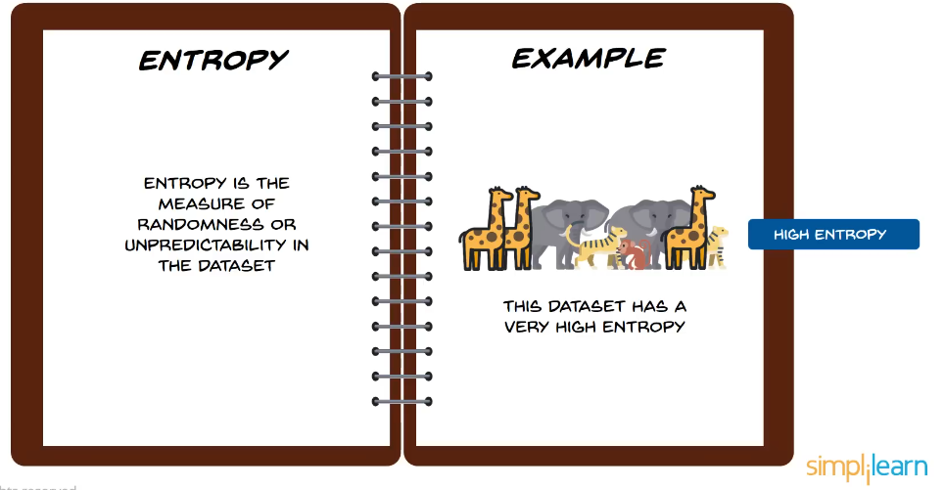
Important terms

Slide 13
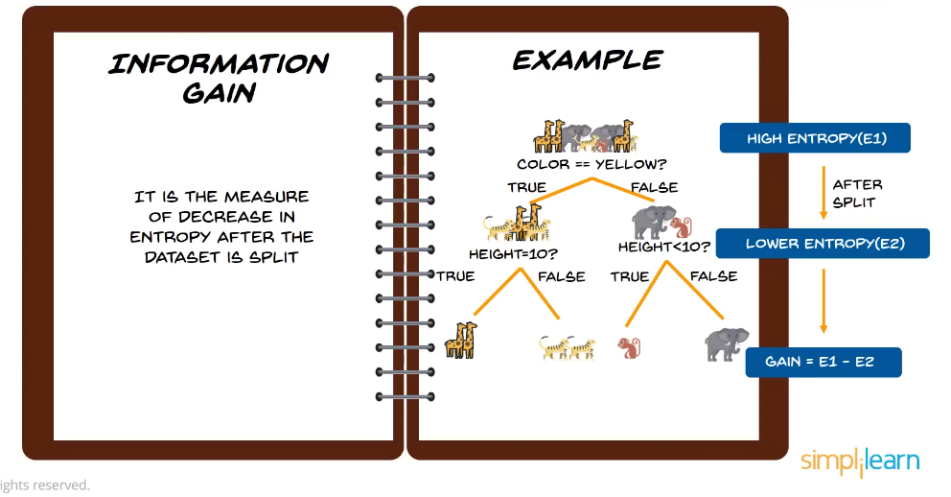

Slide 14
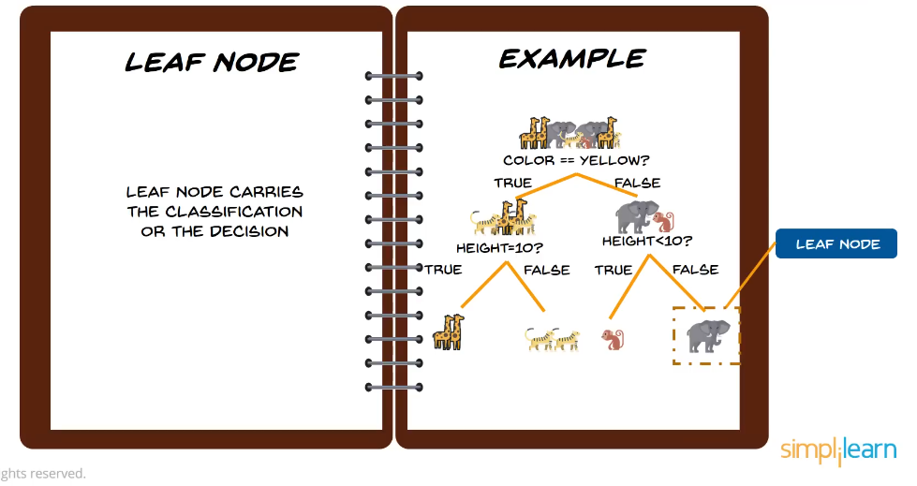

Slide 15
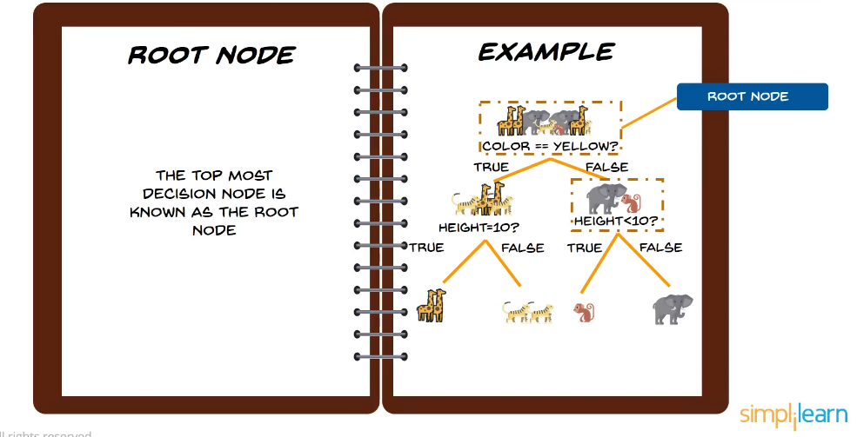

Slide 16
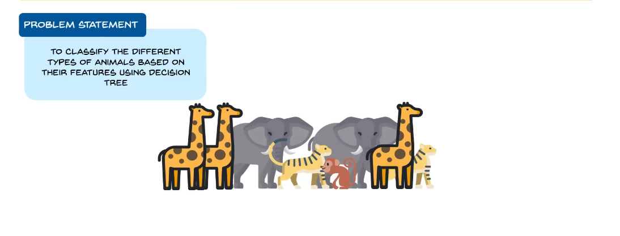
How does the decision tree work?

Slide 17
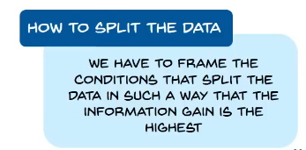
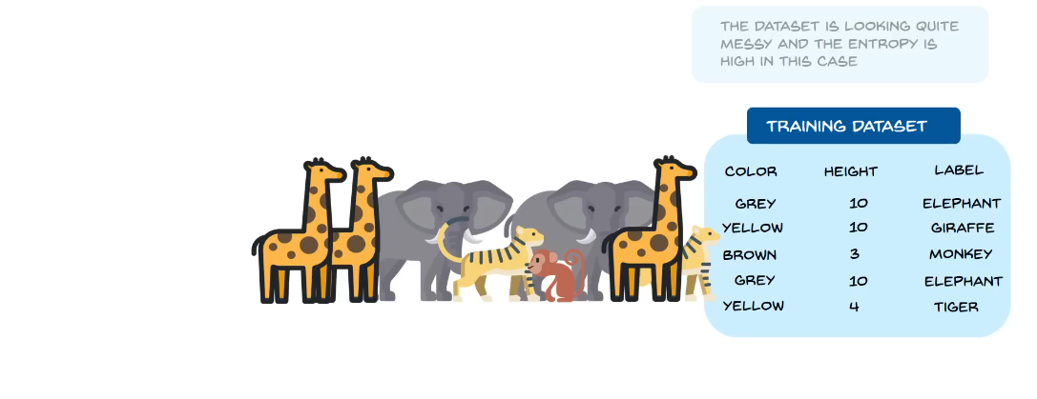

Slide 18
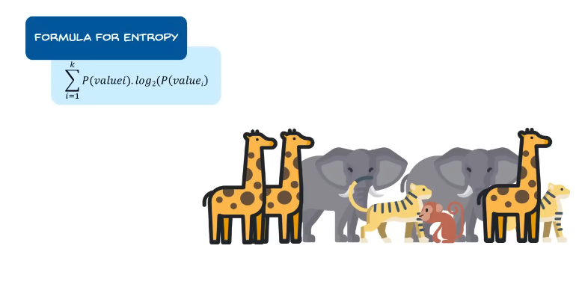

Slide 19
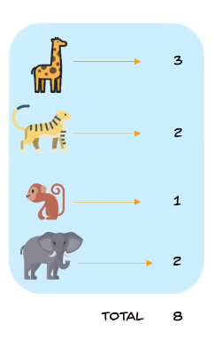
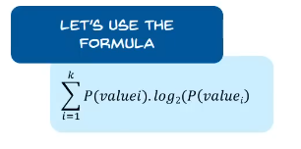
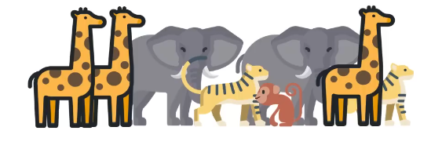
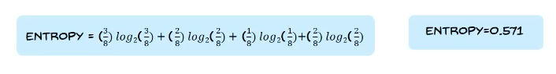

Slide 20
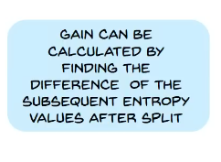
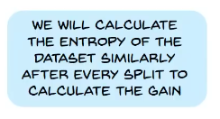
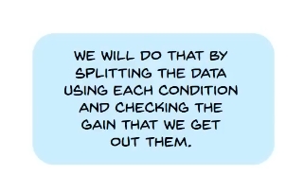
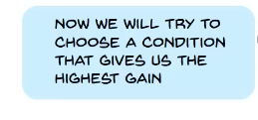
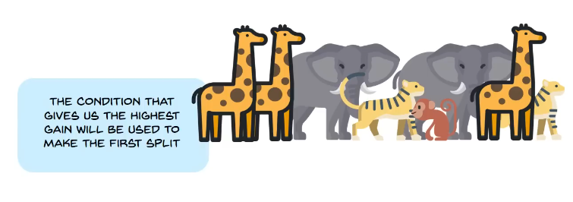

Slide 21
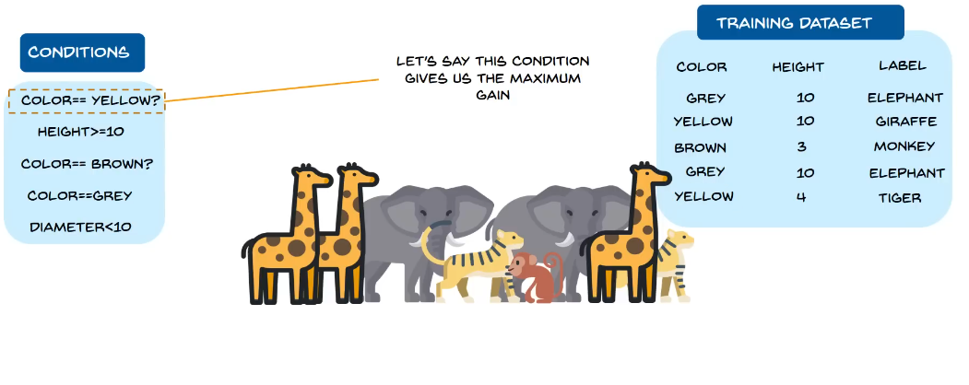

Slide 22
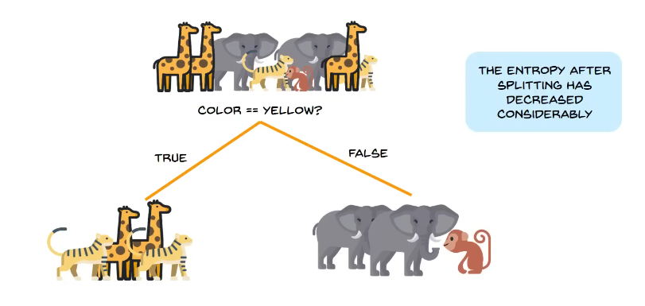

Slide 23
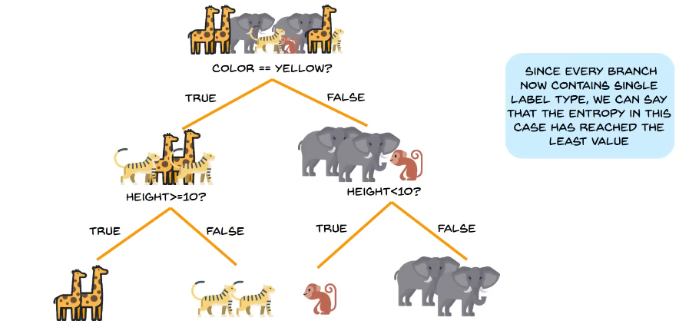

Slide 24
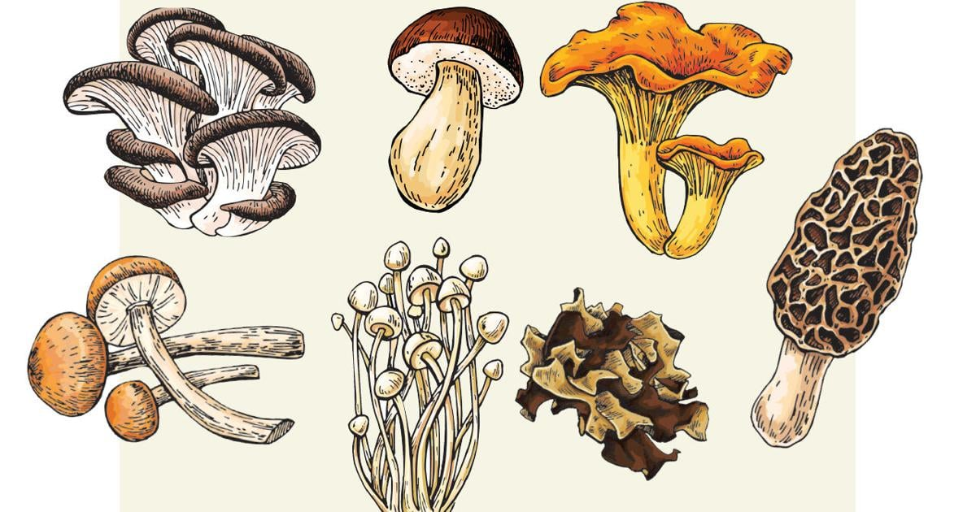
Mushrooms: can I eat it?

Slide 25
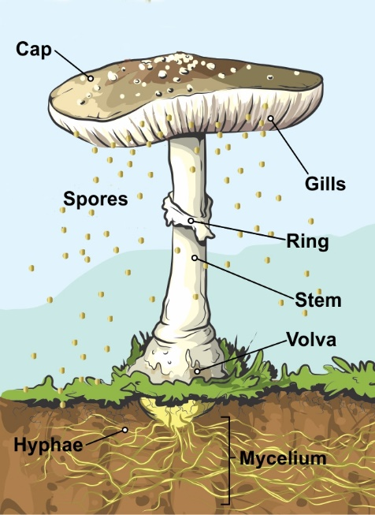
Mushroom parts

Slide 26
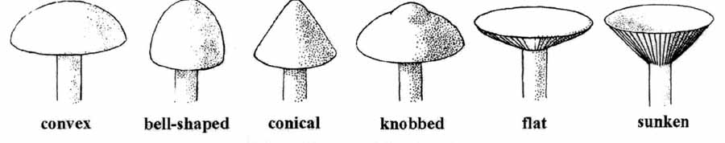
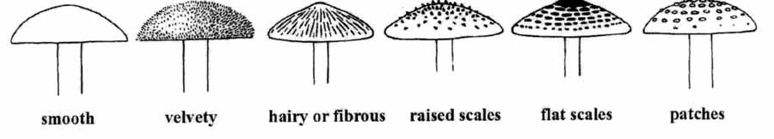
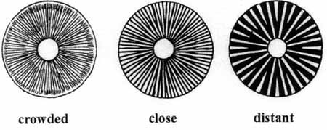
Mushroom cap shape:
Mushroom cap surface:
Mushroom gill spacing:

Slide 27
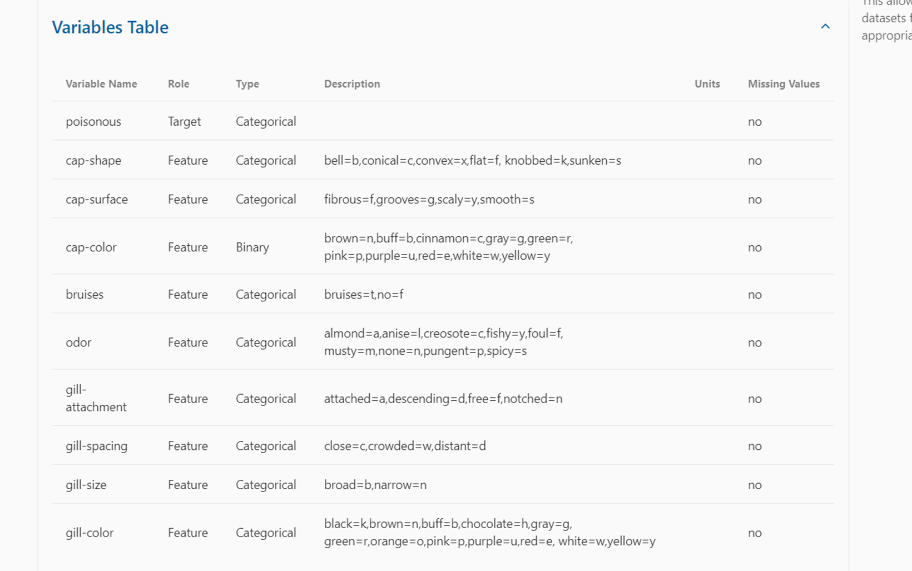

Slide 28
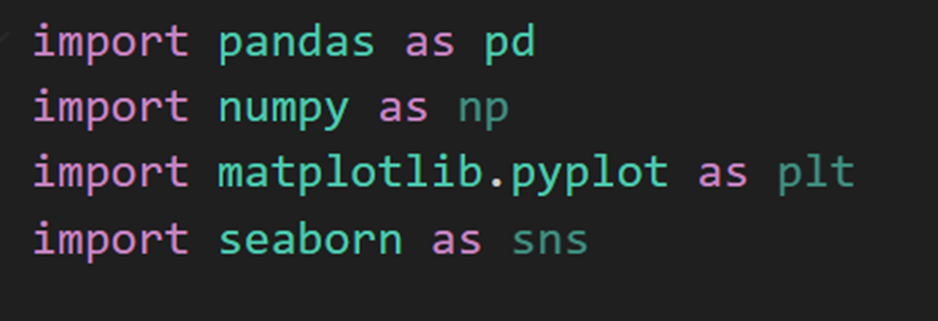
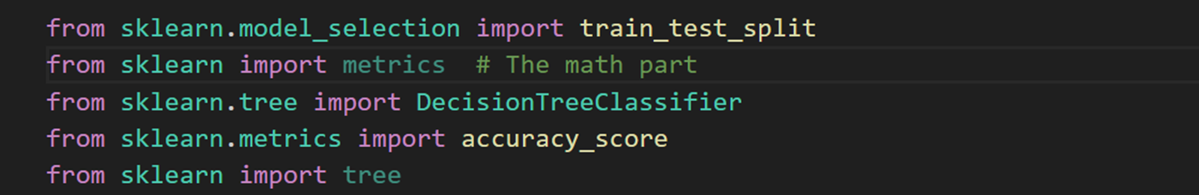
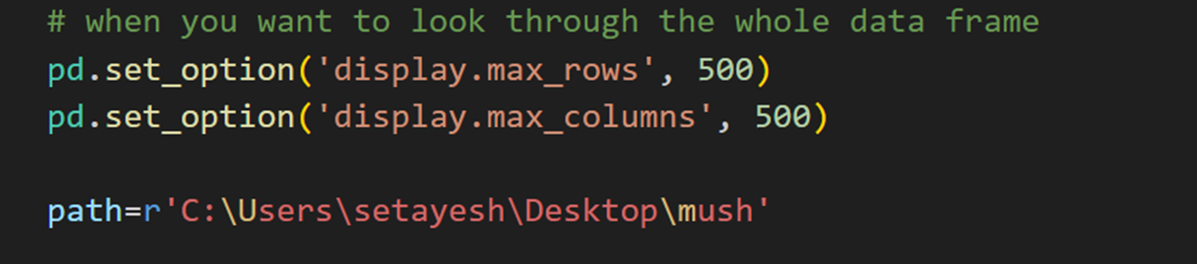
Importing libraries
Showing the table 500*500

Slide 29
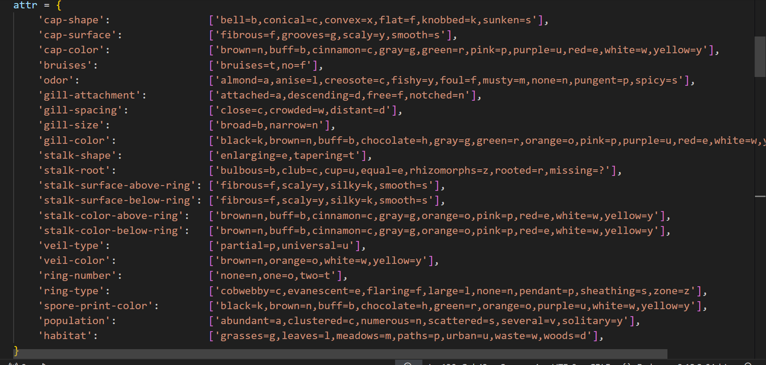
Making a dictionary in python,including feature titles and their attributes

Slide 30
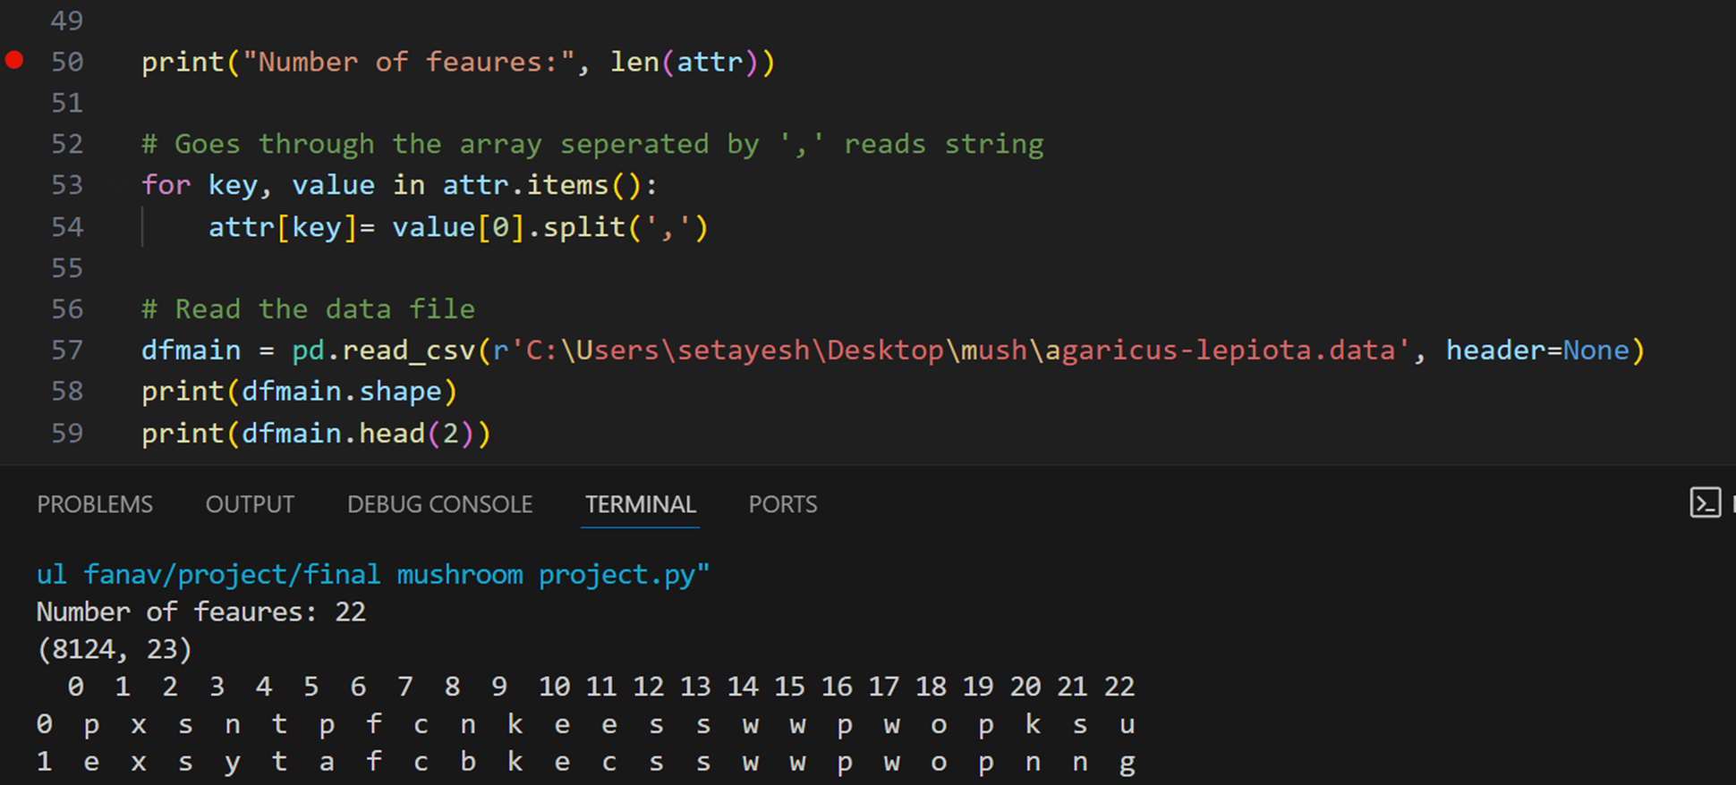
We have 8124 records (rows) and 23 columns (features)
Now we print the first two rows of our data: the columns are 1 to 22 (number of features)
With column 0being our target (edible or poisonous)

Slide 31
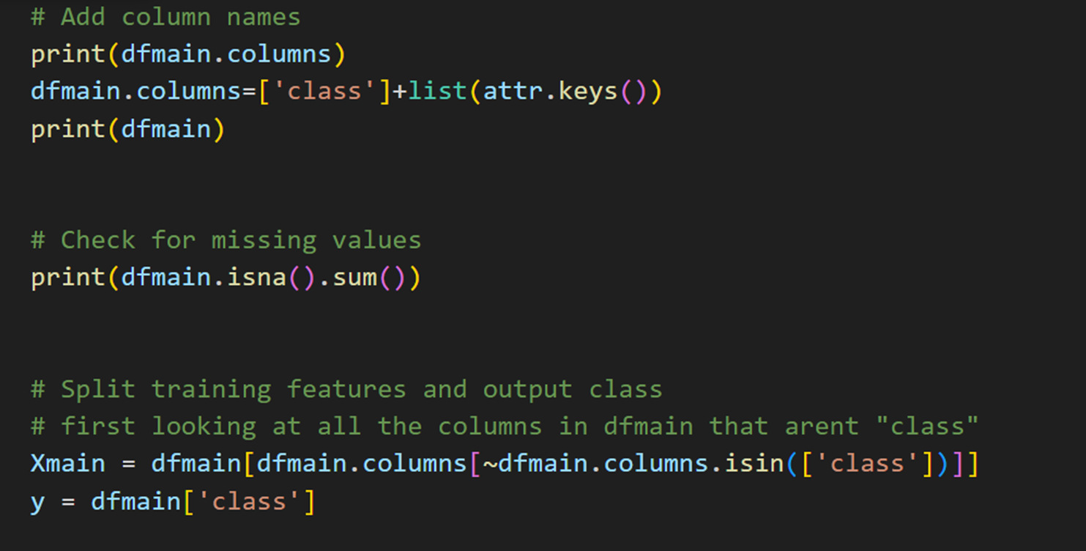
We first add names to our columns using the dictionary we made before.
Then we check for missing values number of null columns in our data which is none
We establish xmain as our features and y as our target class

Slide 32
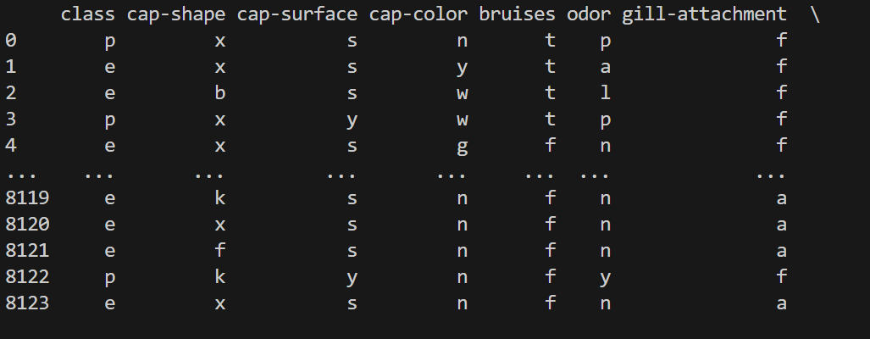
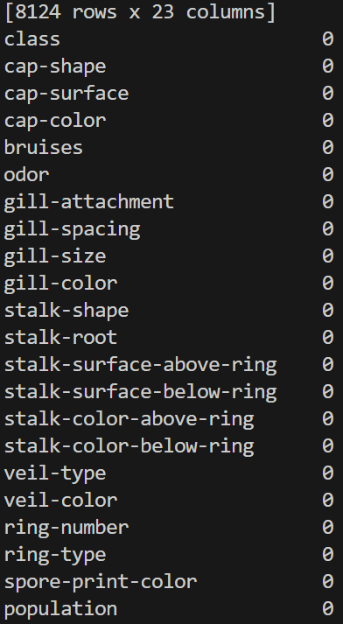

Slide 33
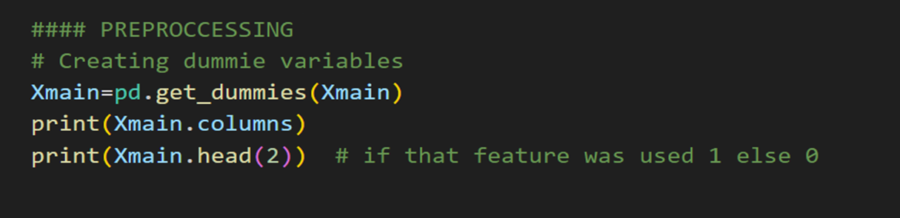
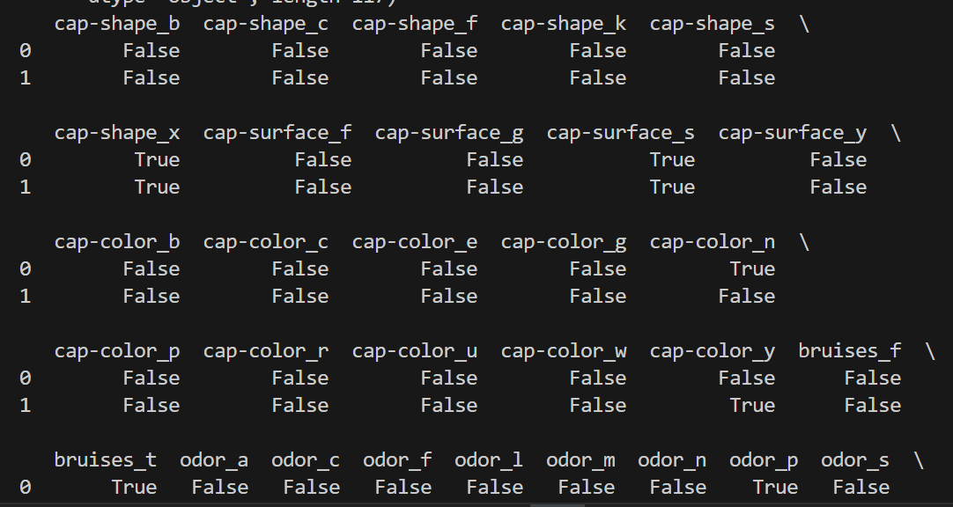
We then make dummie variables
We basically transform our data into 0 and 1s

Slide 34
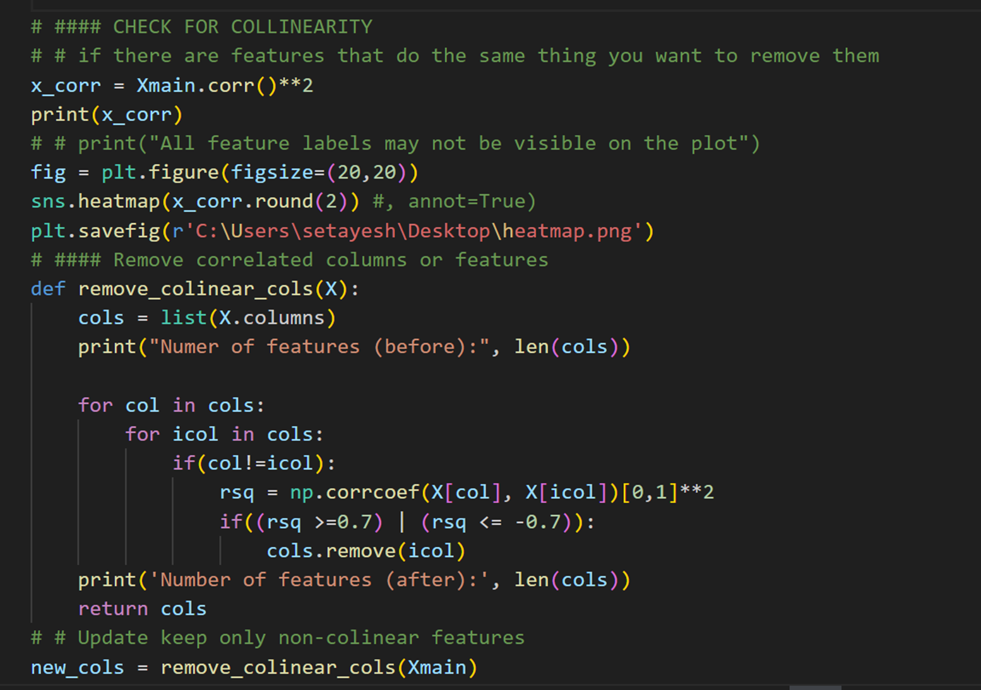

Slide 35
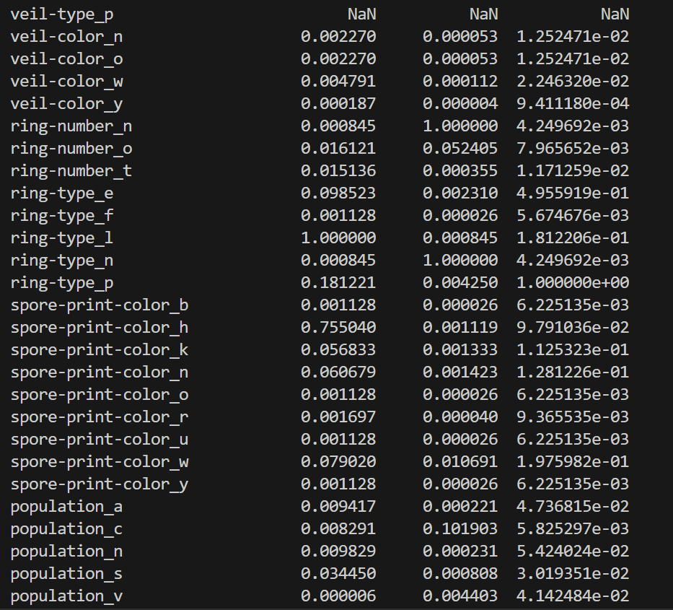

Slide 36
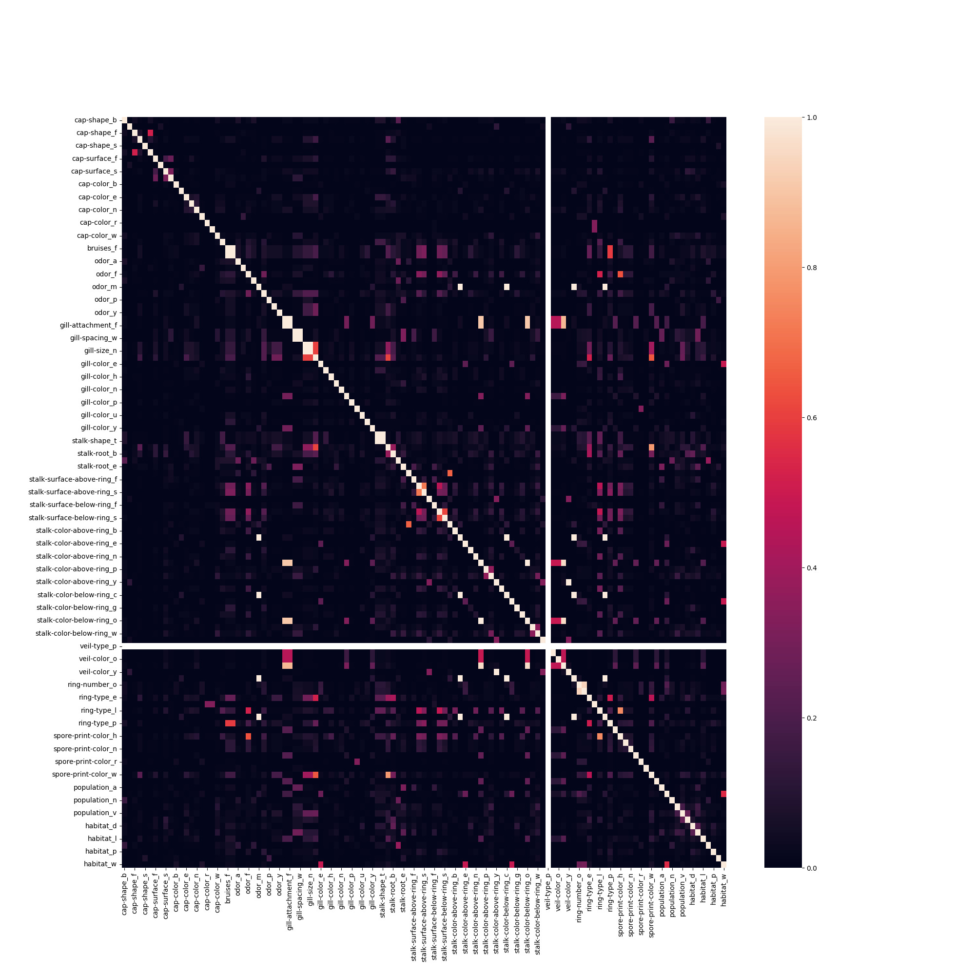

Slide 37
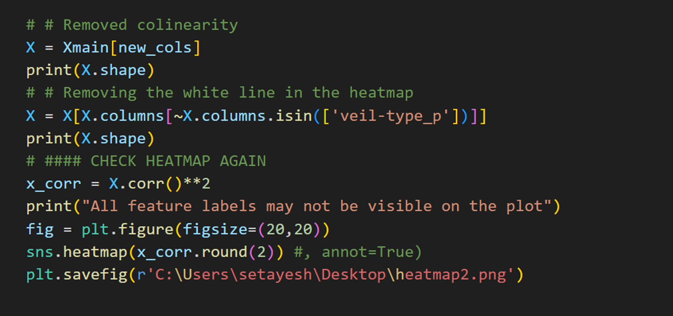

Slide 38
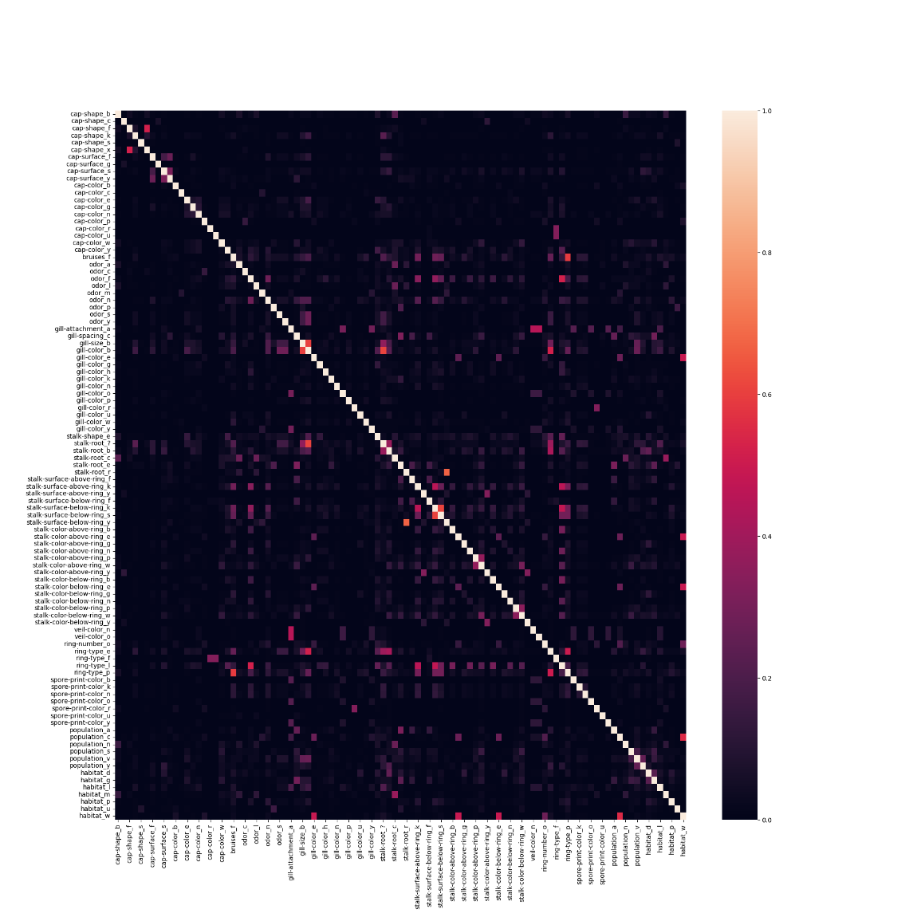

Slide 39
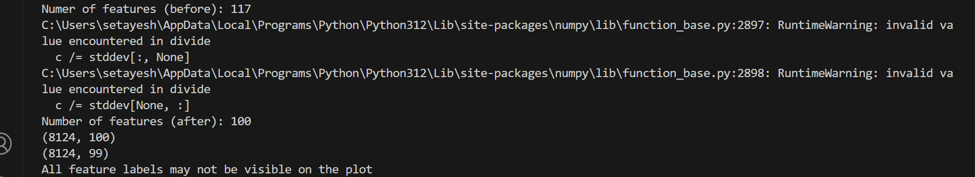

Slide 40
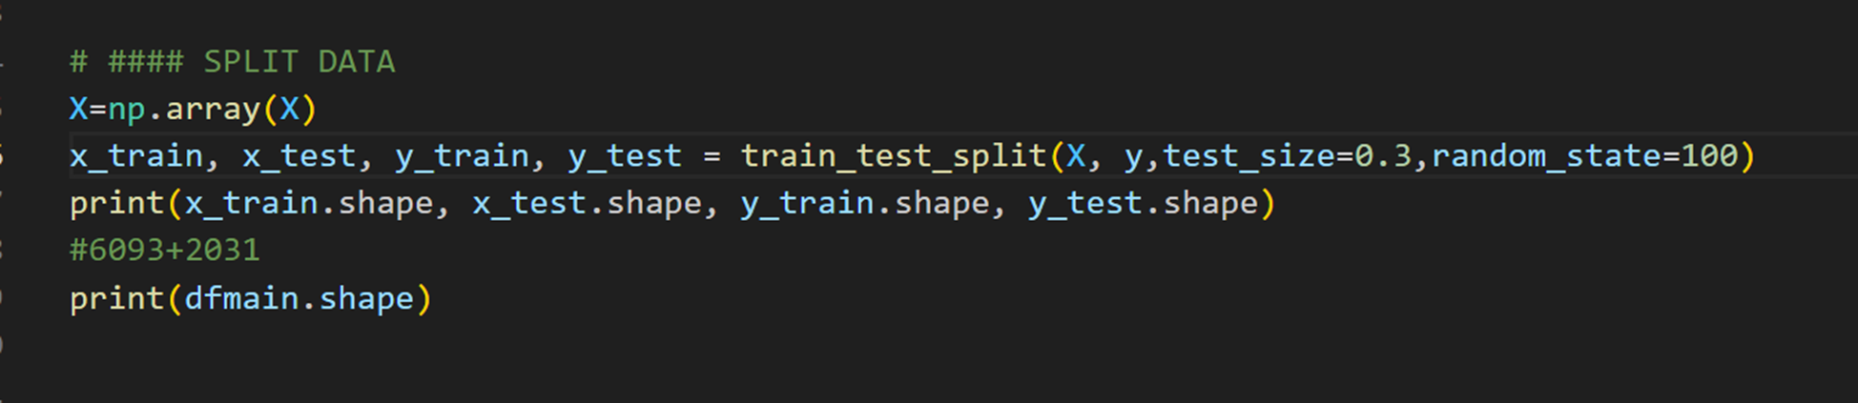
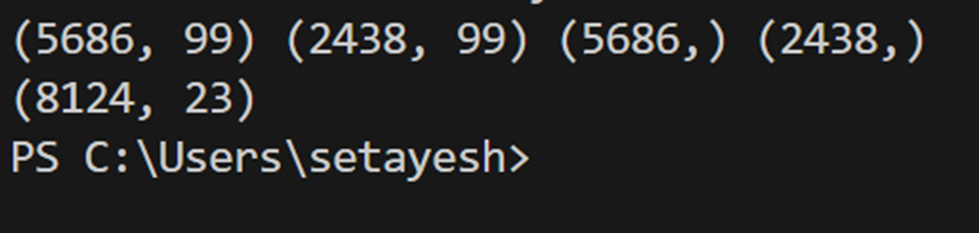
We split the data for our to phases (training, where we train our data and creat our
Decision tree basedon iit and testing, where we test our data in our decision tree) we use
30% of our data for tseting
We split the training and testing data into x and y,
x being our features and y our target class

Slide 41
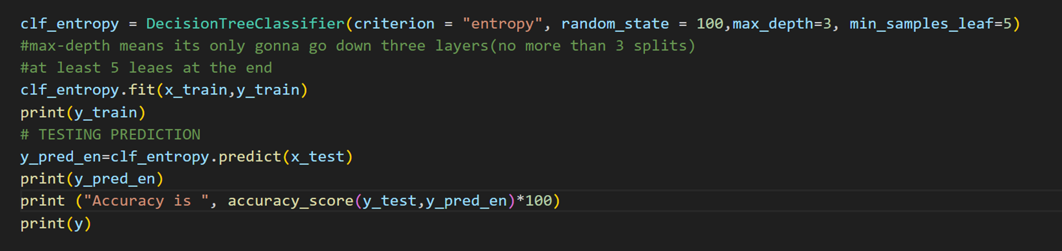
We then call the DecisionTreeClassifier function to make our tree and put our xtrain
and ytain Into the algorithm
Then we test our xtest using predict function
And at last for obtaining the accuracy of our tree we compare our ytest
( the target classes we got by predicting with our tree)and ytrain ( the true answers)

Slide 42
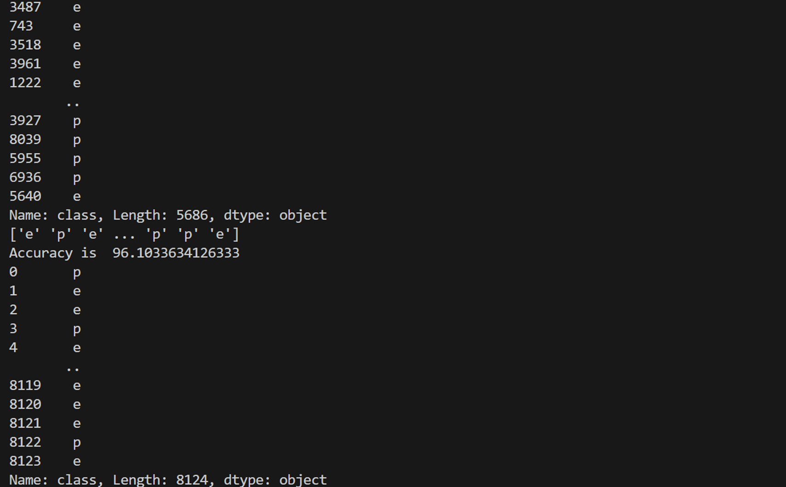

Slide 43
If we have missing values :
1. Deletion (Removing Data)
2. Imputation (Filling in Missing Data)
3. Using Algorithms that Support Missing Values
4. Using Data Augmentation Techniques

Slide 44
Deletion(removing data) :
List-wise Deletion:
Remove any rows that contain missing values.
This method is simple and ensures that only complete cases are used,
but it can lead to a significant reduction in the dataset size,
potentially losing valuable information.
Pairwise Deletion:
Use available data without removing entire rows,
applying analysis only on the available values.
This preserves more data but can result in inconsistent datasets for
different analyses.

Slide 45
Imputation(Filling in missing data):
Mean/Median/Mode Imputation:
Replace missing values with the mean, median, or mode of the respective
column. This method is straightforward and maintains the dataset size but
can reduce variance and may not be suitable for skewed data distributions.
Predictive Modeling:
Use machine learning models like k-Nearest Neighbors (k-NN),
regression, or more complex algorithms to predict and fill in missing values
based on other variables.
This approach can provide more accurate imputed values but is
computationally intensive.
Multiple Imputation:
Create several different imputed datasets and combine the results to
account for the uncertainty around the missing data, leading to more robust
results.

Slide 46
Using algorithms that support missing values :
Certain algorithms, such as decision trees and ensemble methods like Random Forests, can handle missing values natively during the training process. These algorithms can bypass the need for explicit imputation by treating missing values as a separate category or by using surrogate splits.

Slide 47
Using augmentation technique:
Data Augmentation: Generate new data points by perturbing existing data, which can help mitigate the impact of missing values. Techniques like bootstrapping or creating synthetic data can enhance dataset robustness. Iterative Imputation: Iteratively predict and fill in missing values using models trained on other features. This method involves multiple rounds of imputation, with each round using the imputed values from the previous round, often converging to more accurate estimates.

Slide 48
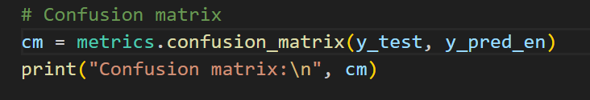

Confusion matrix :

